Slide 1
Long Range Planning
Advisory Committee final recommendation
July 9, 2015

Slide 2
The CIP Review Process
July:
LRPAC Recommendation
August:
Staff Presentation & School Board Approval
September:
OMB + OFD Review Submission
October:
Technical Review Committee rank projects & Financial Review Committee meets
November:
Oversight Committee reviews TRC’s recommendation
December:
Joint Board Meeting to review recommendations
February:
County Executive submits final document to BOS
March:
BOS Work Session on capital budget + public hearings
April:
BOS Adopts Budget
Notes:
BOS may change. Will know more in September

Slide 3
Committee Introduction
Purpose
Per Policy FB: “The Long-Range Planning Advisory Committee (LRPAC) is formed to inform and advise the Superintendent and School Board in the development of comprehensive, long-term plans for facilities needs in the most effective and efficient way and in support of the School Division’s Strategic Plan.”
Membership
School Board Representatives Superintendent Appointees
Anne Shipe, Jouett District Jim Tierney
Andrea Mejia, Rio District Sharon Wood
Daniel Steeper, Rivanna District Randall Switz
Tiffany Barber, Samuel Miller District Graham Paige
Dean Riddick, Scottsville District Jon Stokes
CJ Hatcher, White Hall District
Jennifer McCune , At-Large
Notes:
Rosalyn TO PRESENT
Review the purpose of the committee. Emphasize they are encouraged to provide a needs-based analysis.
The committee has met 12 times over the course of the school year.
Thank the committee for their time, input, and expertise. Ask members to stand and be acknowledged.
Hand over to Dean Riddick, the chairman of the committee.

Slide 4
Committee Introduction (cont.)
Staff Support
Rosalyn Schmitt, Asst. Director of Facilities Planning
Dean Tistadt, COO
Joe Letteri, Director of Building Services
George Shifflett, Deputy Director of Building Services
Renee DeVall, Transportation Analyst
Montie Breeden, Senior Project Manager, OFD
Notes:
Rosalyn TO PRESENT
Review the purpose of the committee. Emphasize they are encouraged to provide a needs-based analysis.
The committee has met 12 times over the course of the school year.
Thank the committee for their time, input, and expertise. Ask members to stand and be acknowledged.
Hand over to Dean Riddick, the chairman of the committee.

Slide 5
Key highlights
Growth
  Past 5 years: +400 students
  Next 5 years: +740 students*
  Next 10 years: +1200 students*
  *Fall 2014 projections
Investment into Existing Facilities
Funding Challenges

Slide 6
recommendation

Slide 7
Redistricting/existing capacity
“Efficient and effective” long range planning = utilizing existing capacity first where feasible.
The LRPAC recommendation is based on the assumption that a feasible redistricting solution can be found to provide immediate relief to Albemarle High School and Greer Elementary. (Ongoing study by redistricting committee to be completed this fall)
In the long-term, this recommendation is also based on assumptions that future redistricting will impact the following schools/areas:
  Baker-Butler
  Walton Middle School (underutilization)
  Urban Ring & Northern Feeder Pattern Elementary Schools in relation to the recommended Woodbrook Addition
  All High Schools in relation to the recommended Monticello High School Addition
  Western Feeder Pattern Elementary Schools in relation to the Crozet Addition

Slide 8
LRPAC FY17 – FY21 CIP Recommendation
RANK | Project | FISCAL YEAR |  |  |  |  | 5 Year Total
 |  | 1 | 2 | 3 | 4 | 5
 |  | 16/17 | 17/18 | 18/19 | 19/20 | 20/21
1 | Maintenance | $ 7,358,465 | $ 6,468,425 | $ 6,886,704 | $ 6,884,222 | $ 7,155,000 | $ 34,752,816
2 | State Technology Grant | $ 752,000 | $ 752,000 | $ 752,000 | $ 752,000 | $ 752,000 | $ 3,760,000
3 | Instructional Technology | $ 575,000 | $ 575,000 | $ 575,000 | $ 575,000 | $ 575,000 | $ 2,875,000
4 | Administrative Technology | $ 261,000 | $ 263,000 | $ 263,000 | $ 263,000 | $ 263,000 | $ 1,313,000
5 | Telecommunications Network Upgrade | $ 900,000 |  |  | $ 900,000 |  | $ 1,800,000
6 | School Bus Replacement | $ 1,200,000 | $ 1,200,000 | $ 1,200,000 | $ 1,200,000 | $ 1,200,000 | $ 6,000,000
7 | Security Improvements | $ 2,391,364 | $ 1,282,222 |  |  |  | $ 3,673,586
8 | Red Hill Modernization | $ 1,067,000 |  |  |  |  | $ 1,067,000
 | Red Hill Additions, Renovations & Site Improvements | $ 293,540 | $ 3,589,437 |  |  |  | $ 3,882,977
9 | Learning Space Modernization | $ 3,000,000 | $ 7,500,000 | $ 10,000,000 | $ 8,000,000 | $ 7,500,000 | $ 36,000,000
10 | Woodbrook Addition + Modernization + Renovation | $ 1,045,065 | $ 12,438,712 |  |  |  | $ 13,483,777
11 | Monticello Addition |  | $ 543,454 | $ 7,229,712 |  |  | $ 7,229,712
12 | Western Albemarle ESA Addition + Renovation |  |  |  | $ 651,685 | $ 6,516,848 | $ 7,168,533
 | TOTAL | $ 18,843,434 | $ 34,612,250 | $ 26,906,416 | $ 19,225,907 | $ 23,961,848 | $ 123,006,401

Slide 9
Continuation projects (1-6)
Maintenance Program
  ~$2mil increase over 5 years
  Updated estimates (roof replacements, HVAC projects, etc.)
Technology Projects
  No changes
School Bus Replacement
  Reduced to 13 busses/year based on maintenance cost study

Slide 10
Security improvements
Project Rank 7 of 12

Slide 11
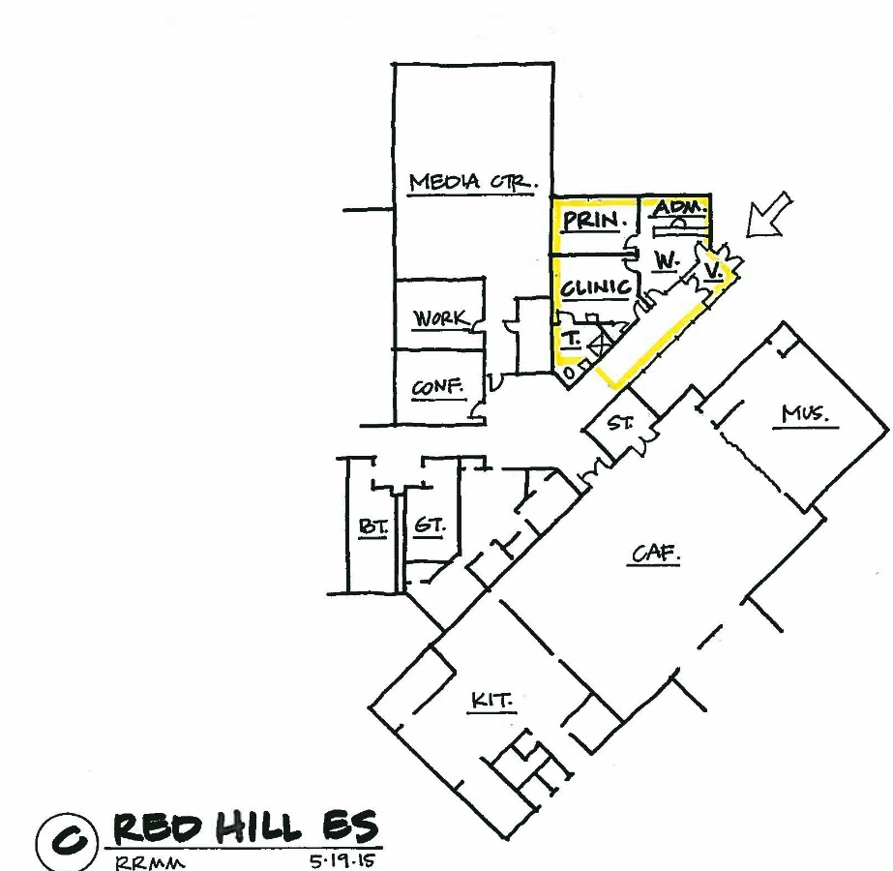
Security improvements
Purpose: Create controlled entrance at the front entrance of all schools
Remaining schools all require small additions to create a controlled entrance
Funding request was increased to repurpose current office spaces
Red Hill added since larger project at school was not approved

Slide 12
Security Improvements
Elementary School | Summer 2014 | Summer 2015 | Summer 2016 | Summer 2017
Broadus Wood | X
Brownsville | X
Crozet | X
Meri. Lewis | X
Murray ES | X
Stone Robinson | X
Stony Point | X
Woodbrook | X
Yancey | X
Cale |  | X
Baker-Butler |  |  | X
Red Hill |  |  | X
Scottsville |  |  | X
Secondary School | Summer 2014 | Summer 2015 | Summer 2016 | Summer 2017
Burley | X
Sutherland | X
Walton | X
Monticello | X
Murray HS |  |  |  | X
WAHS |  | X
Henley |  |  |  | X
Jouett |  |  |  | X
Controlled Entrance already existed at Albemarle HS, Hollymead & Greer
Agnor-Hurt entrance is being redone as part of the larger addition project this summer.

Slide 13
Red hill elementary
Project 8 of 12

Slide 14
Red Hill: Previous review cycle summary
Option | A | B | C
Recommended by | Long Range Planning Advisory Committee (June) | School Board (August), TRC (November), Oversight Committee (December) | APPROVED
Budget | $ 6 mil | $1.2 mil | $100,000*
Schedule | Design: 7/2015 – 3/2016 Construction: 6/2016 -8/ 2017 | Design: 7/ 2015 – 3/2016 Construction: 6/2016 – 8/ 2016 | FY15/16
Addition Scope | Expanded Media Center New Admin Suite New Music Room New Full-size Gym New K-1 Bathrooms | n/a | n/a
Modernization | Media Center Existing Classrooms | Media Center Existing Classrooms | Design for Option B
Renovation Scope | Hallways, bathrooms, support spaces, kitchen equipment & serving line, exterior finishes, existing gym into classrooms | n/a | n/a
* School Board committed this money from the $1million Learning Space Modernization $

Slide 15
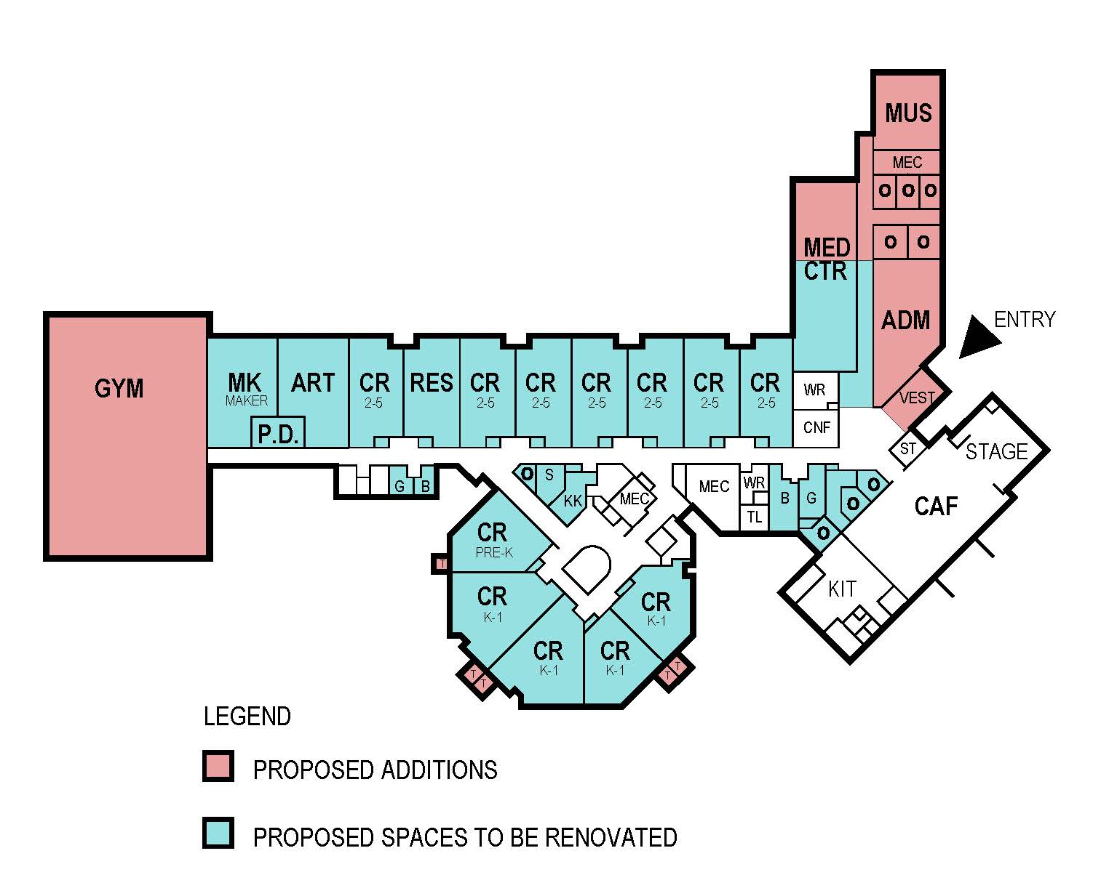
Red Hill Modernization
Previous LRPAC Recommendation

Slide 16
Red Hill Modernization
Current Recommendation
New admin & security entrance in separate project,
but done concurrently

Slide 17
Red Hill Modernization
Phase 1: Modernize Existing Classrooms & Media Center
Design: FY15/16
Construct: Summer 2016
Construction Budget: $1,067,000
Phase 2: Additions, Renovations & Site Improvements
Design: FY16/17
Construct: June 2017 – August 2018
Total Phase 2 Budget: $3,882,977

Slide 18
Red Hill Modernization
SCOPE
Phase 1:
Modernize classrooms & the media center including expanding it into the adjacent classroom.
Phase 2:
Additions (4,500 sf)
  A new Gymnasium and support spaces.
The current gym will be repurposed into an art room & maker space.
Multiple small additions will provide toilets for the existing Grade K-1 classrooms.
Notes:
[Review general scope using bullets]

Slide 19
Red Hill Modernization
SCOPE (cont.)
Renovation:
  Renovate hallways, bathrooms, support spaces
  Upgrade kitchen equipment & serving line
  Update exterior finishes
  Replace interior signage
  Renovate hallways, admin area, toilets, and the various support spaces.
Site Improvements
  Additional parking
  Outdoor learning areas.
Notes:
[Review general scope using bullets]
The scope has been revised to include a new gym and a repurposing of the current one, rather than just expanding the current one.
More defined renovation scope.

Slide 20
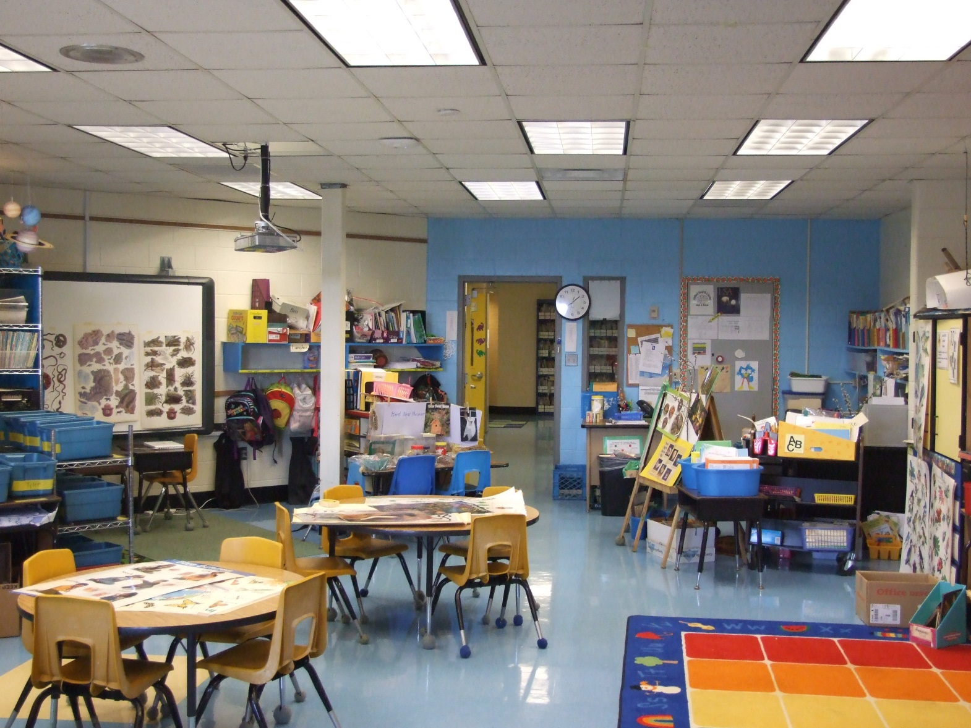
Red Hill Modernization
Typical Pod Classroom
Notes:
Here are some images to give you a visual.
Note the chairs in this image or old and inadequate for today’s standards for ergonomics and student comfort.

Slide 21
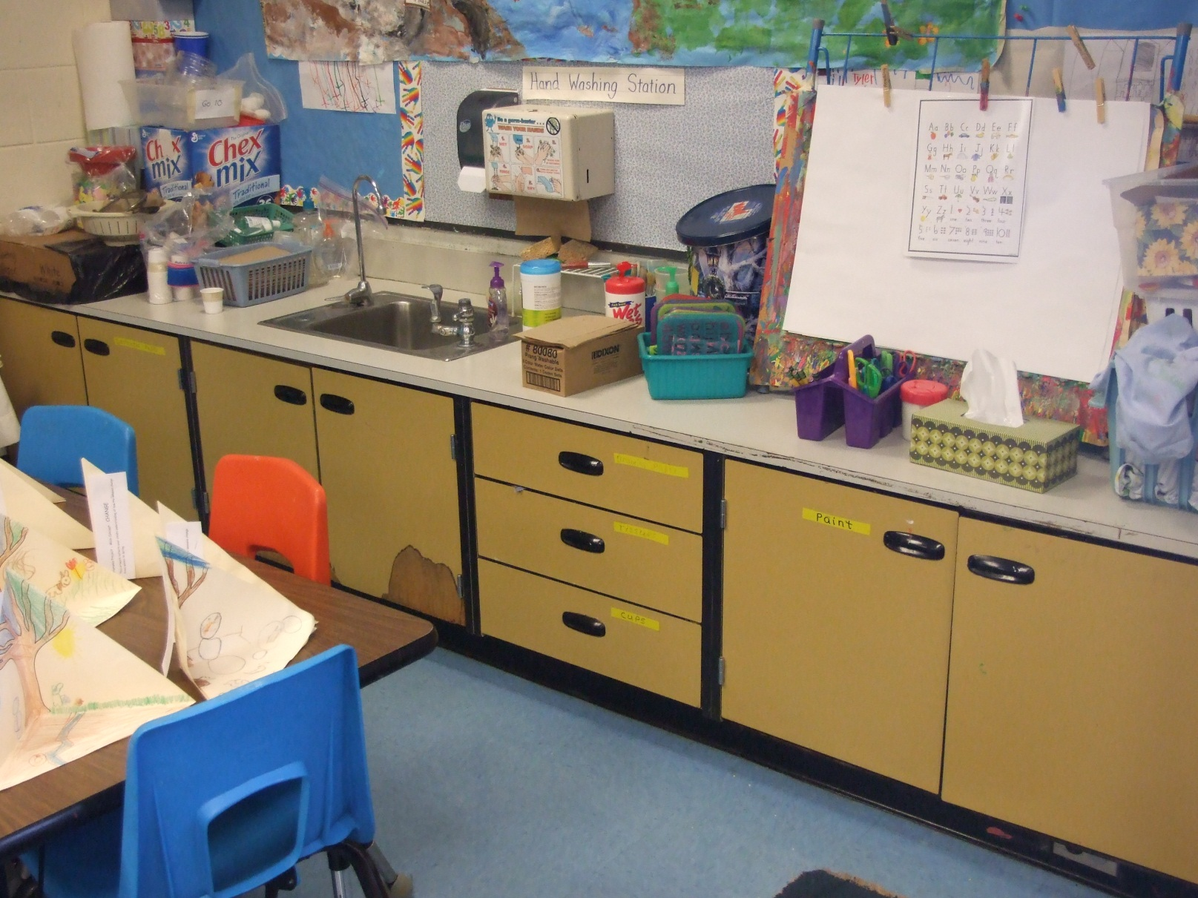
Red Hill Modernization
Classroom Casework
Notes:
The casework needs to be replaced.

Slide 22
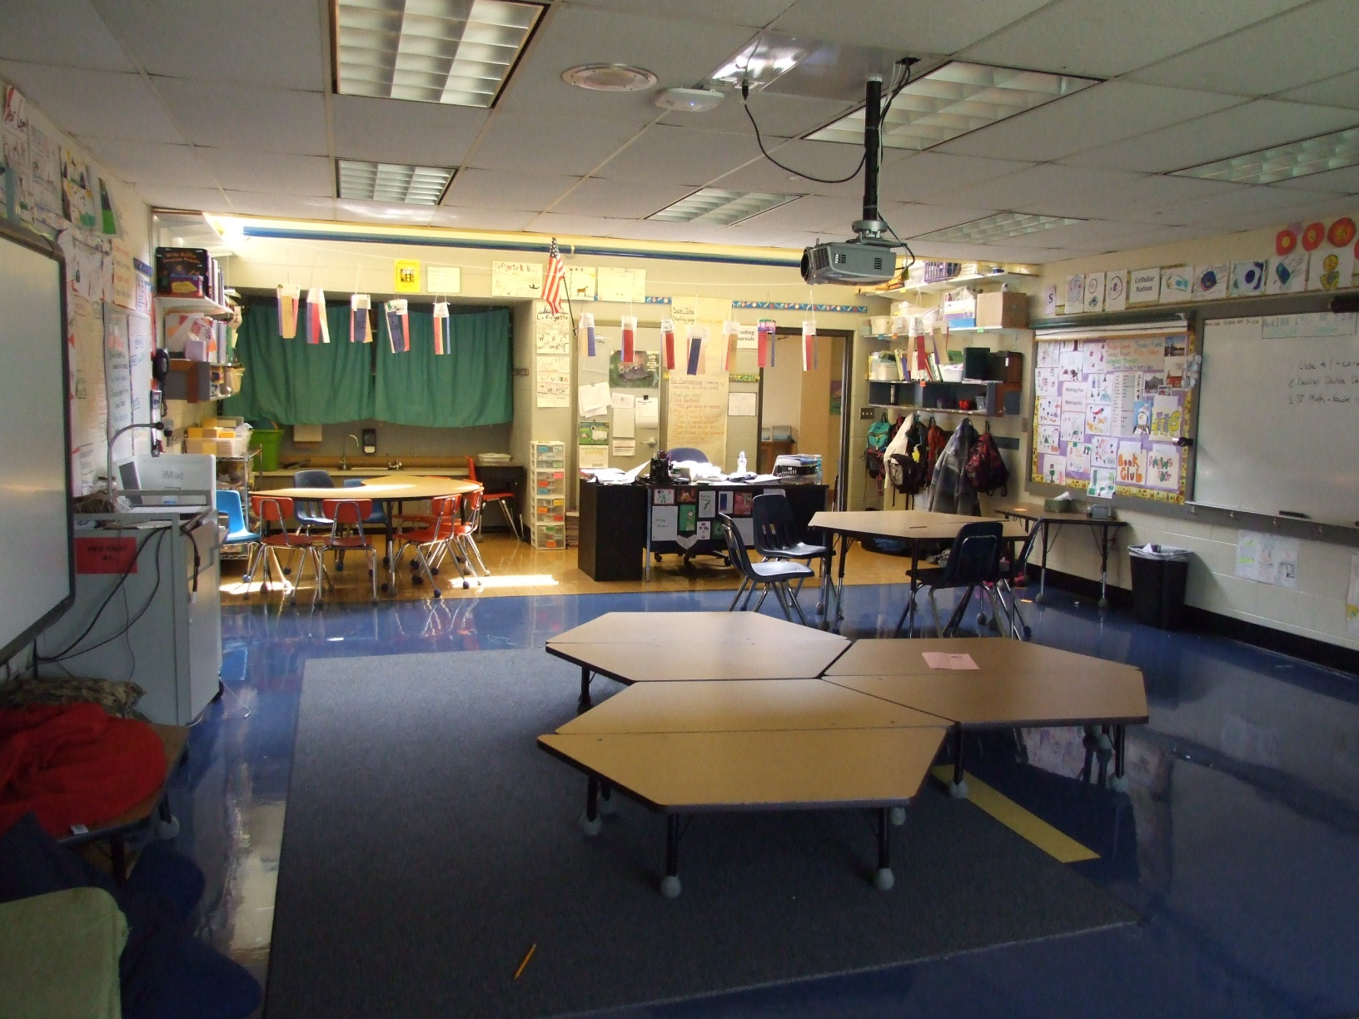
Red Hill Modernization
Typical Classroom

Slide 23
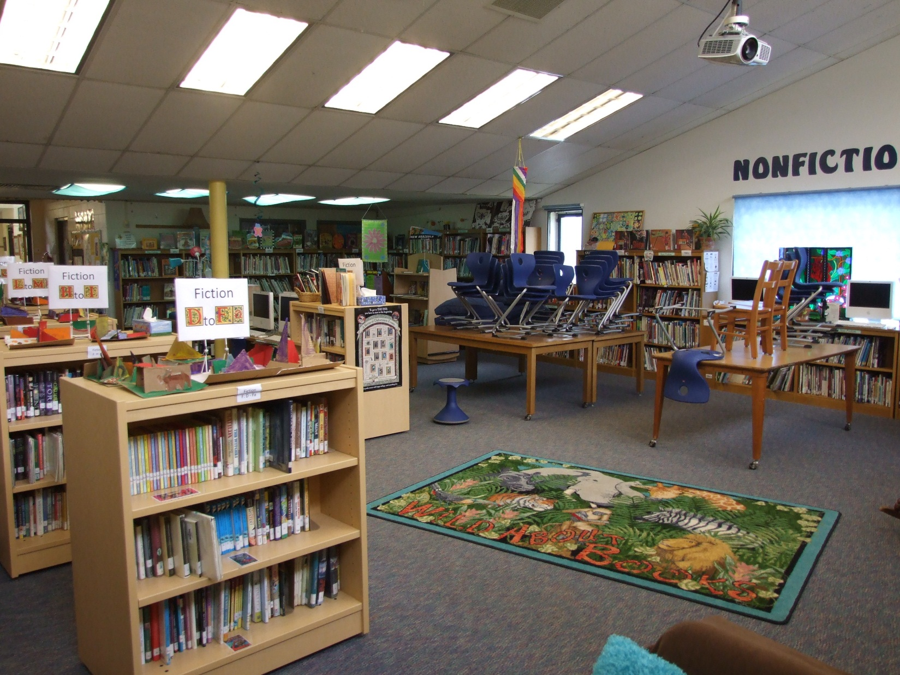
Red Hill Modernization
Undersized Media Center
Notes:
The media center is sized for 100 students based on state guidelines. The school’s enrollment is 50% more than that.

Slide 24
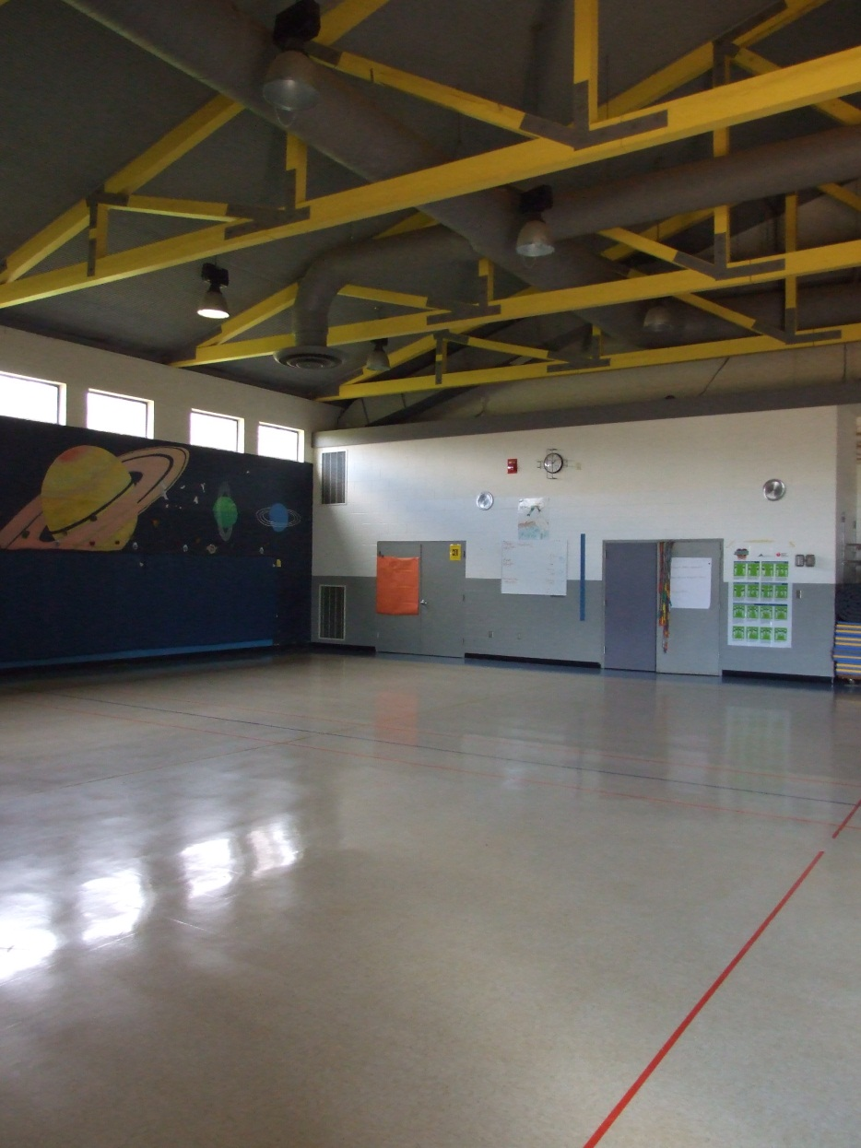
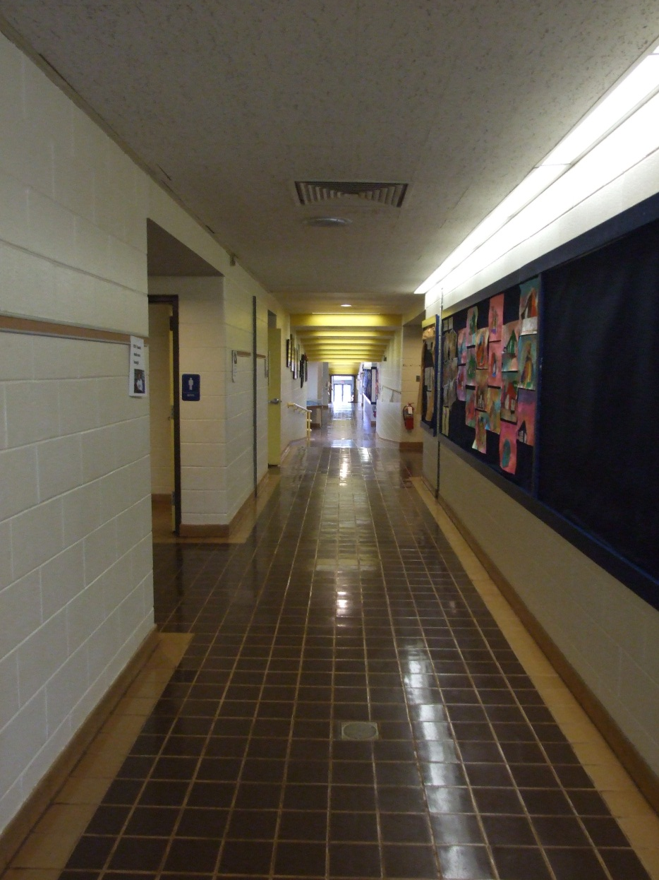
Red Hill Modernization
Hallway
Gym
Notes:
Note image of the hallway with inadequate lighting and outdated ceiling.
The gym is only 2,200 sf. Which is too small for a lot of activities.
[THIS IS THE LAST SLIDE FOR RED HILL, SO EMPHASIZE AGAIN THAT THIS SCHOOL CANNOT CONTINUE TO BE KICKED DOWN THE LIST]

Slide 25
Learning space modernization
Project Rank 9 of 12

Slide 26
Learning Space Modernization
CLASSROOM FURNITURE UPGRADE
Update furniture to create a flexible & comfortable learning environment.
CLASSROOM MODERNIZATION
Renovate classroom spaces to update all finishes, casework, & lighting.
MEDIA CENTER RENOVATION
Renovate media centers to be flexible hubs of congregation, collaboration, & creation.
CAFETERIA RENOVATION
Update cafeteria finishes & furniture.
Renovate existing spaces to create state-of-the-art music, art, CTE & other specialty rooms.
SPECIALTY CLASSROOM RENOVATION
Daylighting
Add day lighting to spaces with no or minimal natural light.
This includes ergonomic seating choice, work surfaces that vary in height & size but are all mobile, & adequate storage.
Improve transparency & connection to adjacent spaces, including the outdoors if feasible.
This includes updating furniture, shelving, and accessory spaces.
Create dedicated maker spaces.
Update blinds or shades in spaces with natural light to better control the light.
Notes:
Targeted work to address outdated spaces
The work can broken down in these key areas.

Slide 27
Learning Space Modernization
School |  | Year 1 | Year 2 | Year 3 | Year 4 | Year 5
Elementary | A |  |  | 10 rooms |  | 10 rooms
 | B |  |  | 10 rooms |  | 10 rooms
 | C |  |  | 10 rooms |  | 10 rooms
 | D |  | Media Center | 10 rooms |  | 10 rooms
 | E |  |  | 10 rooms |  | 10 rooms
 | F |  |  | 10 rooms
 | G |  | Media Center |  |  | 10 rooms
 | H |  | Media Center
 | I |  | Cafeteria
 | J |  |  |  | Media Center
 | K |  | Media Center |  | Cafeteria
 | L |  |  |  | Media Center
Middle | A |  | 10 rooms |  | 20 rooms
 | B |  | 10 rooms |  | 15 rooms
 | C |  | 10 rooms |  | 10 rooms
 | D |  |  | 10 rooms |  | 10 rooms
High | A |  |  | 10 rooms |  | 10 rooms
 | B |  | 20 rooms | Media Center | 30 rooms
 | C |  | 10 rooms | Media Center | 20 rooms
 | D |  |  |  |  | 10 rooms
 | E |  |  | Media Center
SAMPLE
Phasing Plan
Notes:
This is a preliminary plan based upon the current implementation assumptions proposed by staff.

Slide 28
Learning Space Modernization
School |  | Year 1 | Year 2 | Year 3 | Year 4 | Year 5
Elementary | A |  |  | 10 rooms |  | 10 rooms
 | B |  |  | 10 rooms |  | 10 rooms
 | C |  |  | 10 rooms |  | 10 rooms
 | D |  | Media Center | 10 rooms |  | 10 rooms
 | E |  |  | 10 rooms |  | 10 rooms
 | F |  |  | 10 rooms
 | G |  | Media Center |  |  | 10 rooms
 | H |  | Media Center
 | I |  | Cafeteria
 | J |  |  |  | Media Center
 | K |  | Media Center |  | Cafeteria
 | L |  |  |  | Media Center
Middle | A |  | 10 rooms |  | 20 rooms
 | B |  | 10 rooms |  | 15 rooms
 | C |  | 10 rooms |  | 10 rooms
 | D |  |  | 10 rooms |  | 10 rooms
High | A |  |  | 10 rooms |  | 10 rooms
 | B |  | 20 rooms | Media Center | 30 rooms
 | C |  | 10 rooms | Media Center | 20 rooms
 | D |  |  |  |  | 10 rooms
 | E |  |  | Media Center
Specific locations would be identified.
Plan would not complete a whole school before moving onto the next.
Work at larger schools would be completed in 2 year cycle to allow for a year of evaluation.
All schools would have some sort of work in the first 3 years.
Phasing Plan

Slide 29
Woodbrook elementary addition, modernization & renovation
Project 10 of 12

Slide 30
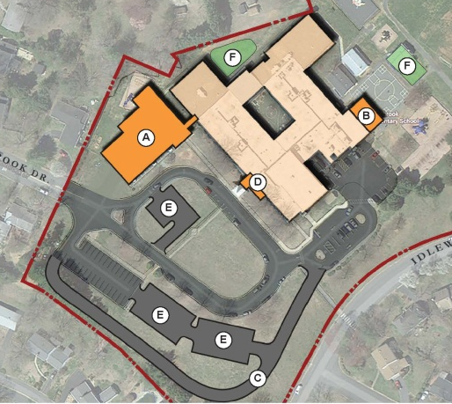
Woodbrook Addition & Modernization
Timing: Open for 2018/19 School Year
Renovation Complete for 2019/20 School Year
Total Budget: $ 13,483,777
Purpose: Address Urban Ring Capacity Deficit
Notes:
It is in response to growth and capacity issues not only at this school, but the urban ring in general.

Slide 31
Woodbrook Addition & Modernization
Projected Urban Ring Seating Deficits
School | 2015/16 | 2019/20 | 2024/25 | # of Trailers
Agnor-Hurt | 46 | 6 | -27 | 0
Baker-Butler | 9 | -40 | -93 | 0
Cale | -4 | -5 | -30 | 2
Greer | -47 | -101 | -84 | 2
Hollymead | -17 | -9 | -27 | 2
Woodbrook | 6 | 7 | -5 | 3
Total | -7 | -142 | -266 | 9
Notes:
1 year, 5 year & 10 year projections

Slide 32
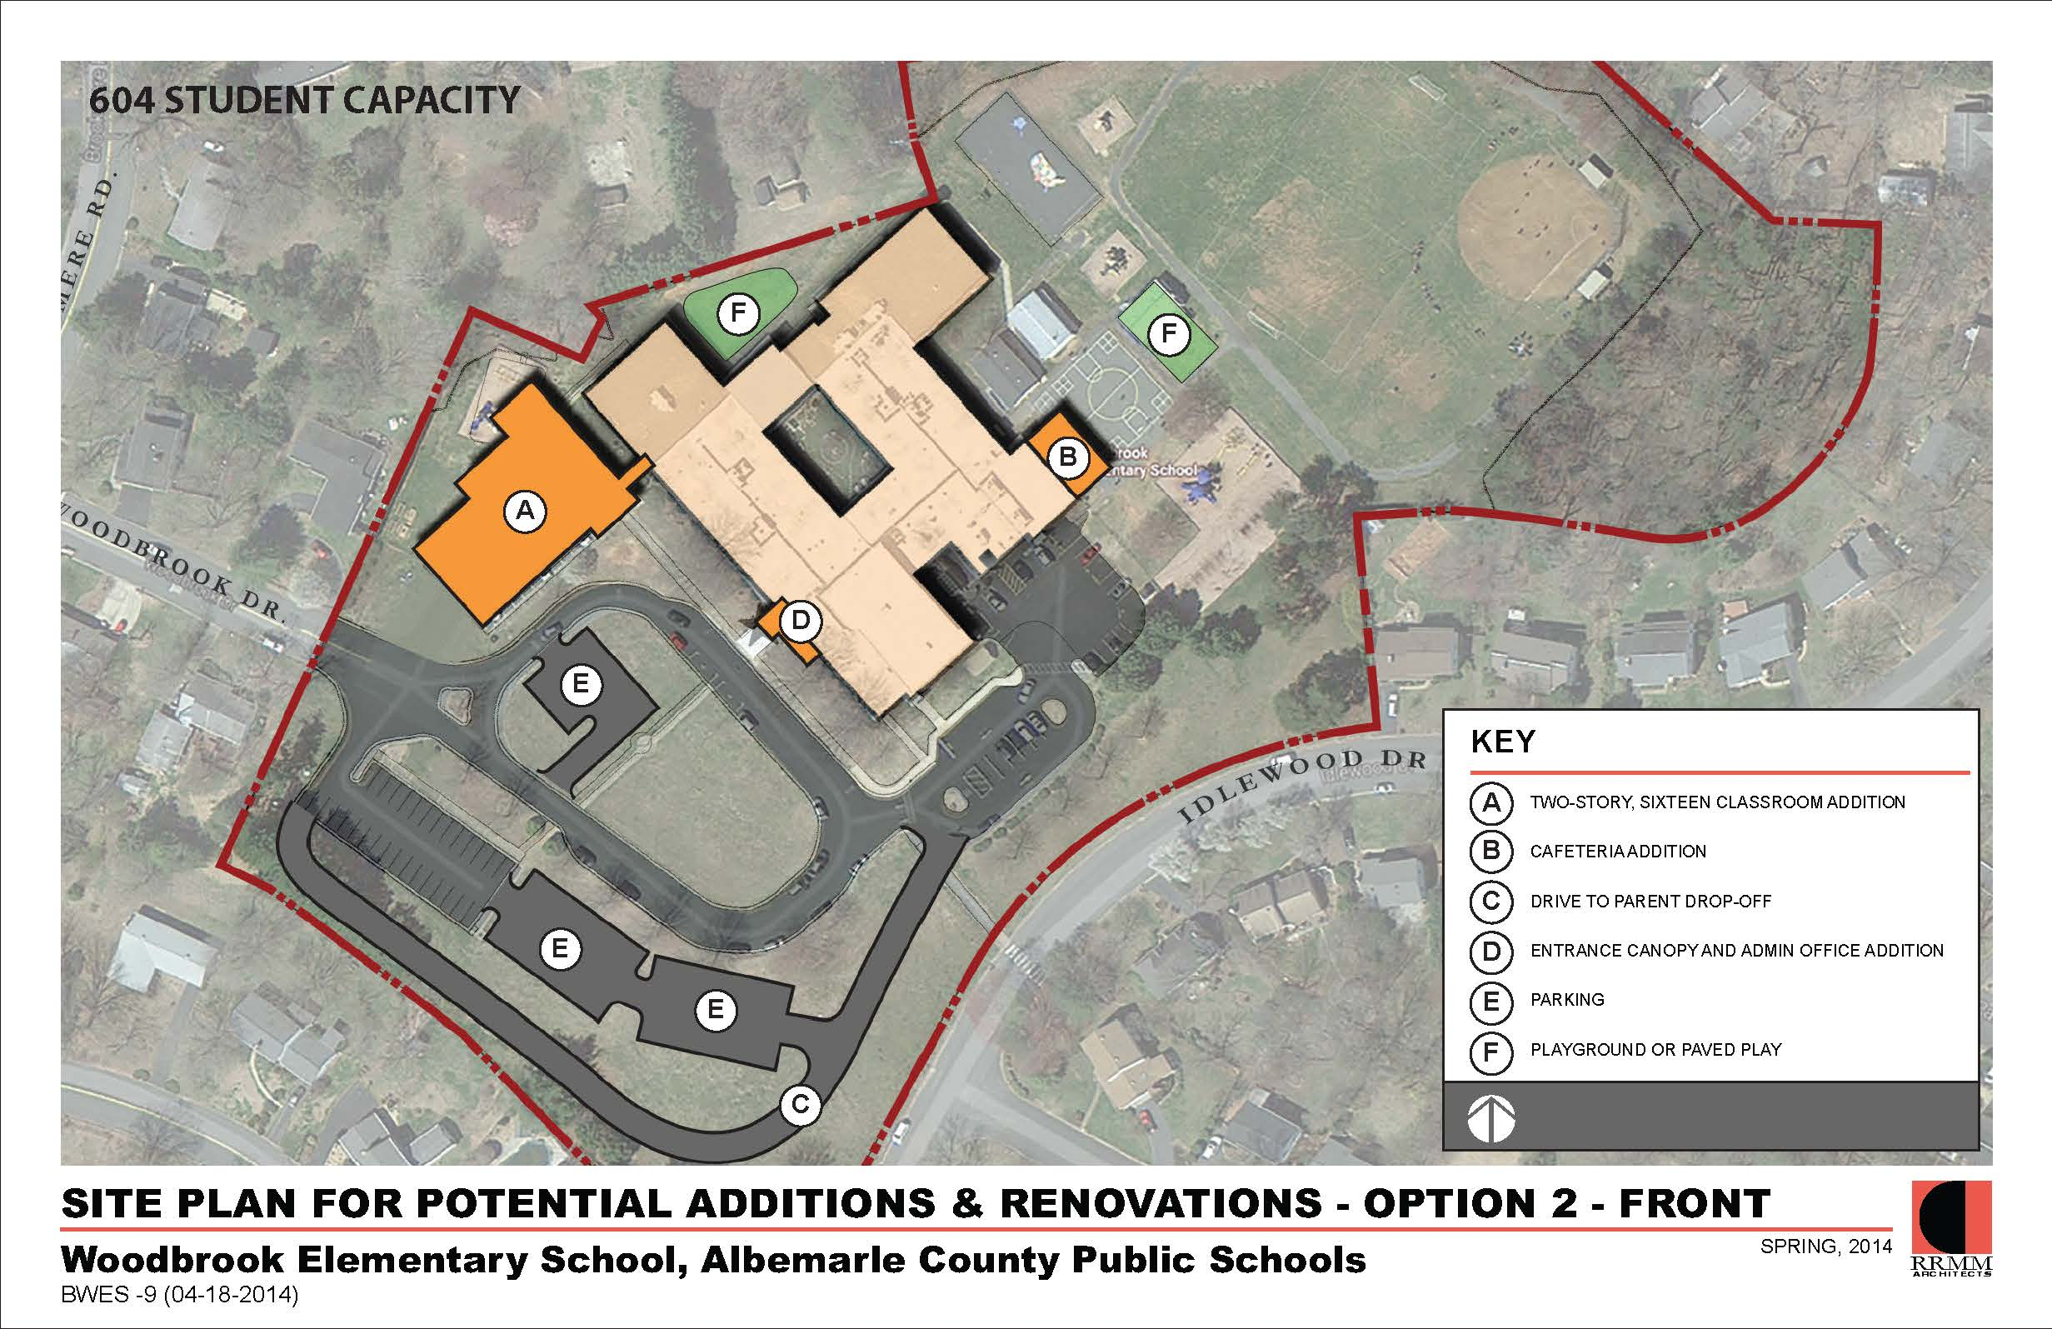
Woodbrook Addition & Modernization
*Gym addition
not illustrated
Notes:
Here is an over all plan of Woodbrook.

Slide 33
Woodbrook Addition & Modernization
SCOPE
Additions (40,000 sf)
  16 classrooms (2 story)
  2 SPED Rooms
  Maker Space
  Professional Development training space
  Expanded Cafeteria
  A new Gymnasium and support spaces.
Notes:
[Review bullet points]
Point out the addition could go either on the front of the building or the back of the building
The gym addition is not shown, but it would a full size facility like Greer’s new gym.
Acknowledge that this is bigger than the projections call for. Due to the central location of the school, trends of growth after Greer addition and potentially Agnor-Hurt growth. The increased size is justified. Additional space could be used for other programs as well.
There is a smaller alternative if the Board would like it for consideration.

Slide 34
Woodbrook Addition & Modernization
SCOPE (cont.)
Improvements to the existing building include:
  Classroom modernization
  Media Center modernization
  Kitchen & Serving Line Improvements/Upgrades
  Cafeteria Renovation
  ADA Improvements
  Renovate bathrooms
  Expand admin area
  New signage
  New electrical switch gear
Notes:
Comment that it would also include a complete renovation of the current building. (no need to review each item)

Slide 35
Monticello high school addition
Project Rank 11 of 12

Slide 36
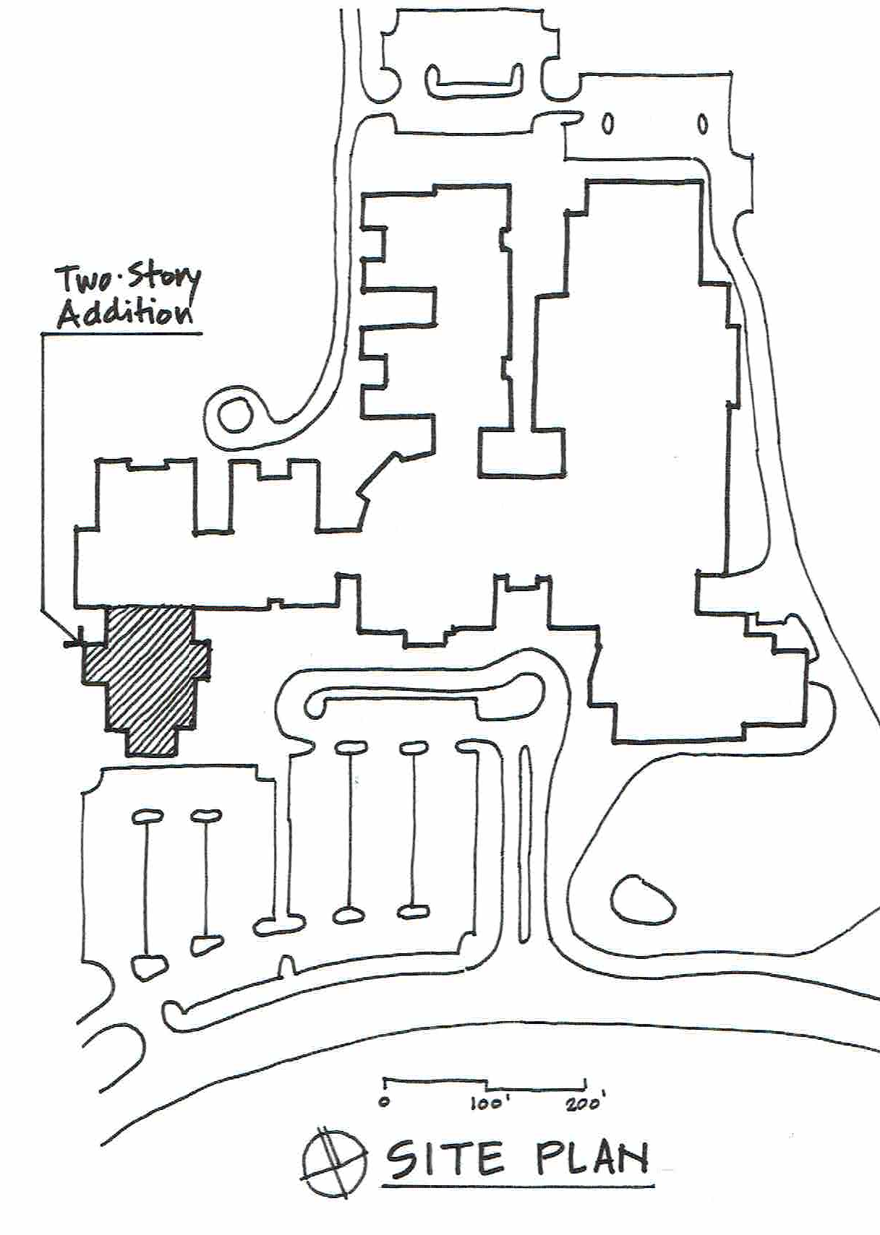
Monticello HS addition
Timing: Open for the 2019/20 School Year
Budget: $7,229,712
Purpose: Address district-wide shortage of high school seats
Projected Seating Deficits
High School | 1 Yr | 5 Yr | 10 yr
Albemarle | (132) | (223) | (487)
Monticello | 108 | 147 | 116
Western Albemarle | 33 | (59) | (160)
Total | 9 | (135) | (531)

Slide 37
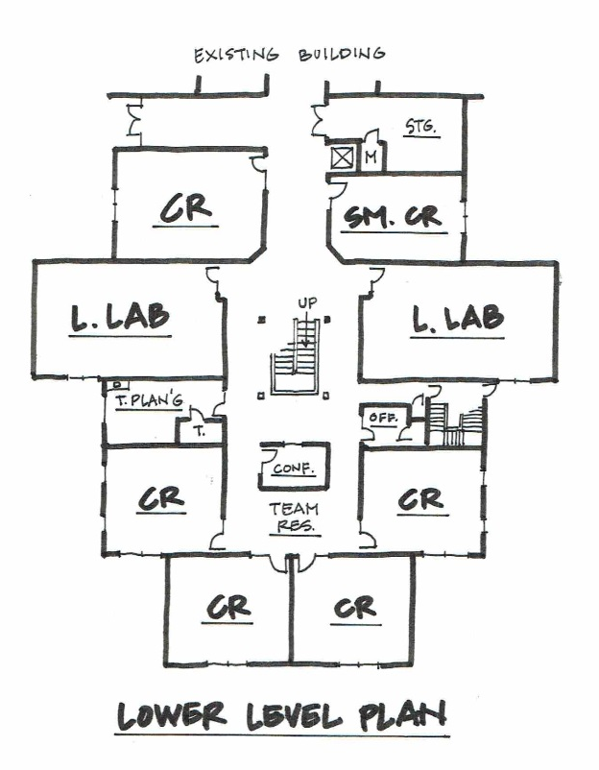
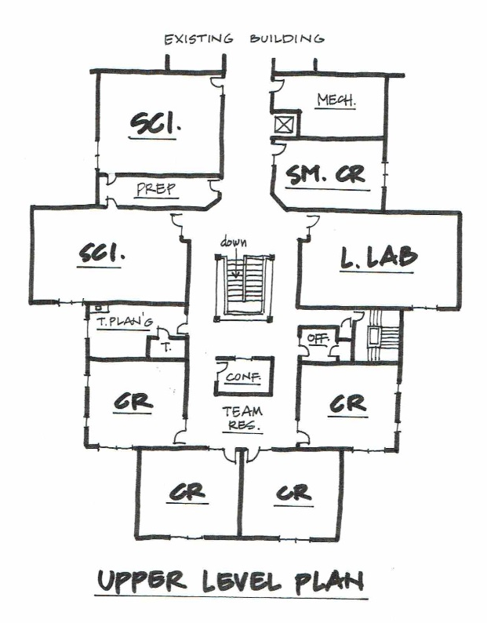
Monticello HS addition
Scope:
24,500 sf, 250 Seat Addition
  9 classrooms
  2 science classrooms
  3 learning labs
  2 smaller classrooms
  Associated spaces such as teacher planning rooms, faculty toilets, conference rooms, an elevator, storage, utility rooms, etc.

Slide 38
Western Albemarle High School renovation & ESA Addition
Project 12 of 12

Slide 39

WAHS renovation* & ESA Addition
Timing: Open for 2022/23 School Year
Budget: $ 7,168,533
Purpose: Support School Board Initiative (academy) & update a dated building
*To be completed in conjunction with Learning Space Modernization projects at the school
Notes:
Next

Slide 40
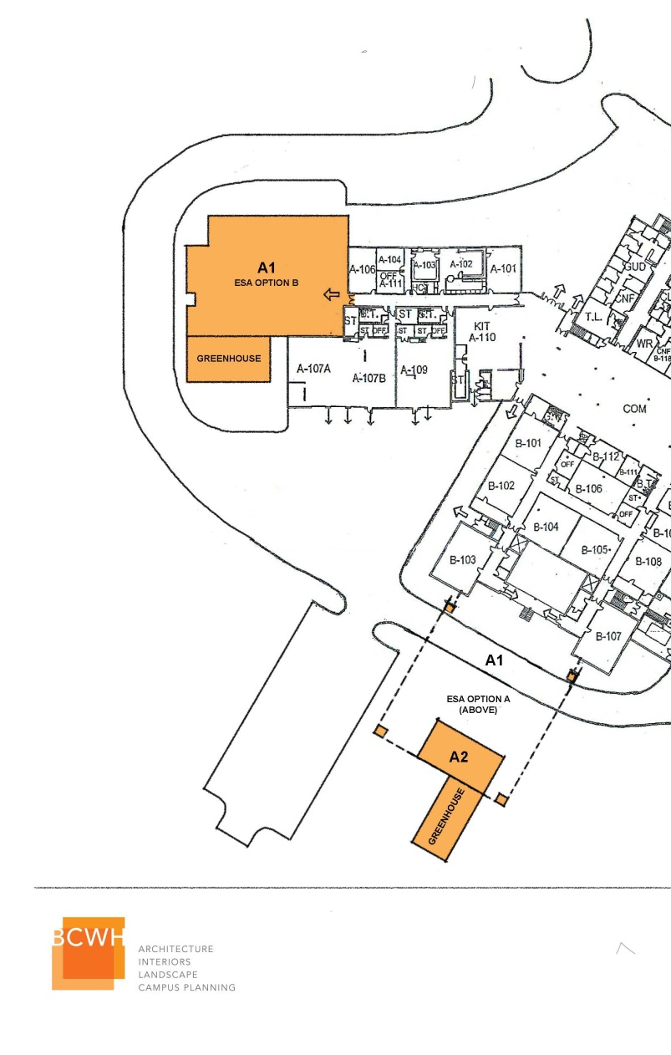
WAHS renovation & ESA Addition
SCOPE
Renovations to the existing building:
  Locker removal
  Ceiling replacement
  Lighting upgrades
  Painting
  Flooring replacement.
  Exterior metal panels replacement
Phase 2: Environmental Studies Academy Addition
  10,000 sf
  Three science labs, “dark room” / planetarium, offices, a shared prep room with storage, and project spaces for independent, collaborative teaming.
  Spaces will accommodate hydro / aqua activities and hydroponics.
Notes:
Phase 1 is a greenhouse
Phase 2 is an addition which would add 3 state of the art science lab

Slide 41
Out year projects FY22/23 – FY26/27
Crozet Elementary Addition
Stony Point Elementary Addition
Yancey Elementary Addition/Renovations
Western Albemarle High School Addition
CATEC
Administration Space
Land Acquisition
Pre-K Expansion

Slide 42
LRPAC FY17 – FY21 CIP Recommendation
RANK | Project | FISCAL YEAR |  |  |  |  | 5 Year Total
 |  | 1 | 2 | 3 | 4 | 5
 |  | 16/17 | 17/18 | 18/19 | 19/20 | 20/21
1 | Maintenance | $ 7,358,465 | $ 6,468,425 | $ 6,886,704 | $ 6,884,222 | $ 7,155,000 | $ 34,752,816
2 | State Technology Grant | $ 752,000 | $ 752,000 | $ 752,000 | $ 752,000 | $ 752,000 | $ 3,760,000
3 | Instructional Technology | $ 575,000 | $ 575,000 | $ 575,000 | $ 575,000 | $ 575,000 | $ 2,875,000
4 | Administrative Technology | $ 261,000 | $ 263,000 | $ 263,000 | $ 263,000 | $ 263,000 | $ 1,313,000
5 | Telecommunications Network Upgrade | $ 900,000 |  |  | $ 900,000 |  | $ 1,800,000
6 | School Bus Replacement | $ 1,200,000 | $ 1,200,000 | $ 1,200,000 | $ 1,200,000 | $ 1,200,000 | $ 6,000,000
7 | Security Improvements | $ 2,391,364 | $ 1,282,222 |  |  |  | $ 3,673,586
8 | Red Hill Modernization | $ 1,067,000 |  |  |  |  | $ 1,067,000
 | Red Hill Additions, Renovations & Site Improvements | $ 293,540 | $ 3,589,437 |  |  |  | $ 3,882,977
9 | Learning Space Modernization | $ 3,000,000 | $ 7,500,000 | $ 10,000,000 | $ 8,000,000 | $ 7,500,000 | $ 36,000,000
10 | Woodbrook Addition + Modernization + Renovation | $ 1,045,065 | $ 12,438,712 |  |  |  | $ 13,483,777
11 | Monticello Addition |  | $ 543,454 | $ 7,229,712 |  |  | $ 7,229,712
12 | Western Albemarle ESA Addition + Renovation |  |  |  | $ 651,685 | $ 6,516,848 | $ 7,168,533
 | TOTAL | $ 18,843,434 | $ 34,612,250 | $ 26,906,416 | $ 19,225,907 | $ 23,961,848 | $ 123,006,401

Slide 43
Financial reality
RANK | Project | FISCAL YEAR |  |  |  |  | 5 Year Total
 |  | 1 | 2 | 3 | 4 | 5
 |  | 16/17 | 17/18 | 18/19 | 19/20 | 20/21
1 | Maintenance | $ 7,358,465 | $ 6,468,425 | $ 6,886,704 | $ 6,884,222 | $ 7,155,000 | $ 34,752,816
2 | State Technology Grant | $ 752,000 | $ 752,000 | $ 752,000 | $ 752,000 | $ 752,000 | $ 3,760,000
3 | Instructional Technology | $ 575,000 | $ 575,000 | $ 575,000 | $ 575,000 | $ 575,000 | $ 2,875,000
4 | Administrative Technology | $ 261,000 | $ 263,000 | $ 263,000 | $ 263,000 | $ 263,000 | $ 1,313,000
5 | Telecommunications Network Upgrade | $ 900,000 |  |  | $ 900,000 |  | $ 1,800,000
6 | School Bus Replacement | $ 1,200,000 | $ 1,200,000 | $ 1,200,000 | $ 1,200,000 | $ 1,200,000 | $ 6,000,000
7 | Security Improvements | $ 2,391,364 | $ 1,282,222 |  |  |  | $ 3,673,586
8 | Red Hill Modernization | $ 1,067,000 |  |  |  |  | $ 1,067,000
 | Red Hill Additions, Renovations & Site Improvements | $ 293,540 | $ 3,589,437 |  |  |  | $ 3,882,977
9 | Learning Space Modernization | $ 3,000,000 | $ 7,500,000 | $ 10,000,000 | $ 8,000,000 | $ 7,500,000 | $ 36,000,000
10 | Woodbrook Addition + Modernization + Renovation | $ 1,045,065 | $ 12,438,712 |  |  |  | $ 13,483,777
11 | Monticello Addition |  | $ 543,454 | $ 7,229,712 |  |  | $ 7,229,712
12 | Western Albemarle ESA Addition + Renovation |  |  |  | $ 651,685 | $ 6,516,848 | $ 7,168,533
 | TOTAL | $ 18,843,434 | $ 34,612,250 | $ 26,906,416 | $ 19,225,907 | $ 23,961,848 | $ 123,006,401
NOT FUNDED
2014 BOS APPROVED:
$11,731,358
$9,853,245
$9,646,704
$10,003,722
n/a

